Slide 1
KEY FINDINGS
9.7% of customers have churned
Majority of the consumption and customers that have churned are from ‘ foosdfpfkusacimwkcsosbicdxkicaua channel ’
Although for customers who consume gas and electricity from Powerco, the total number of churn is lower compared to those who do not, the proportional difference says otherwise, making it difficult to say if there is any relationship between churn and consumer choice.
For the code of the electricity campaign the customer first subscribed to, the code with the highest churn is ''lxidpiddsbxsbosboudacockeimpuepw''. However, proportionally, 'ldkssxwpmemidmecebumciepifcamkci’ appears to have churned a lot more.
When considering the years of antiquity, churn occurs amongst consumers with 3-6 years of antiquity. The majority of the customer base falls within 2 to 7 years of Antiquity
When looking at the consumption of Electricity for the past 12 months and consumer choice of whether to have gas, most of the churned consumption comes from customers who do not consume Gas.
For the code of the electricity campaign the customer first subscribed to, the code with the highest churned consumption for the past 12 months in electricity and gas is ''lxidpiddsbxsbosboudacockeimpuepw‘’. This also reflects in the proportions.
Most churn has happened to products activated in 2012, modified, and renewed in 2015. Most of the churned contracts ended in 2016.
Total consumption churned for the past 12 months is 111,905,857.0 units
Total Forecast consumption churned for the next 12 months is 2,785,301.09 units.
Proportionally, A lot more churn has been forecasted to occur within the next 12 months proportionally. However, the consumption of electricity churn for the past 12 months is much higher in value compared to the forecasted value of consumption churn or consumption in general.
Lastly, the distribution of most of the variables are skewed and will require some transformations and standardization during modeling

Slide 2
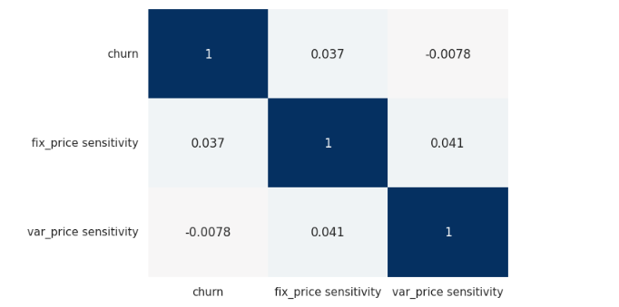
PRICE SENSITIVITY
Price sensitivity measures the changes in consumption resulting from changes in prices. To calculate this, we find the percentage change in consumption and divide it by the percentage change in price for the various customers. This was done with the variable prices and the fixed prices separately.
The results show very little correlation between churn and price sensitivity

